Slide 1
Welcome to our Services
Members are always Appreciated
Visitors are always Honored Guests

Slide 2

STRIFE IS FORBIDDEN
What Is Christianity Really All About?

Slide 3
1.If [there be] therefore any consolation in Christ, if any comfort of love, if any fellowship of the Spirit, if any bowels and mercies, 2. Fulfil ye my joy, that ye be likeminded, having the same love, [being] of one accord, of one mind. 3. [Let] nothing [be done] through strife or vainglory; but in lowliness of mind let each esteem other better than themselves. 4. Look not every man on his own things, but every man also on the things of others……….. 14. Do all things without murmurings and disputings: - KJV

Slide 4
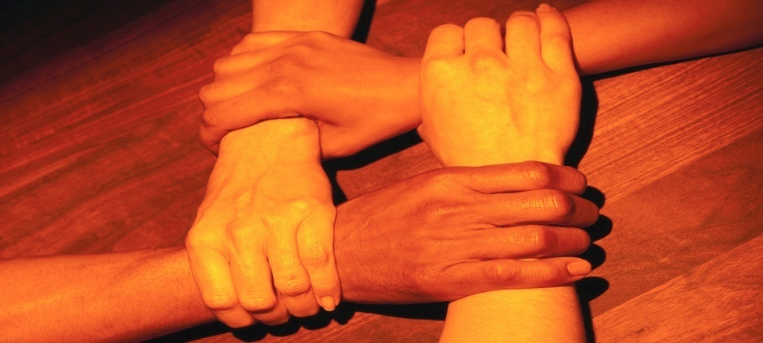
STRIFE IS FORBIDDEN
Introduction:
We are continuing our thought - “WHAT IS CHRISTIANITY REALLY ALL ABOUT?”
Last Sunday we saw that it is about “Not Grieving the Holy Spirit”
This Evening we will consider, in part, the Topic of “UNITY”.

Slide 5
STRIFE IS FORBIDDEN
4. Ephesians 4:1 ”I therefore, the prisoner of the Lord, beseech you that ye walk worthy of the vocation wherewith ye are called, 2. With all lowliness and meekness, with longsuffering, forbearing one another in love;
3. Endeavoring to keep the unity of the Spirit in the bond of peace.”

Slide 6
STRIFE IS FORBIDDEN
5. This Command of God – “Endeavoring to keep the unity of the Spirit in the bond of peace.” given through the H.S., through Paul, can not be kept if the Command that there be no Strife is not kept as well.
6. You can not view or read any form of media today without hearing and seeing Strife and it’s effects.
7. World Leaders beg for resolution to the strife situations through out the world.

Slide 7
STRIFE IS FORBIDDEN
8. STRIFE SEEMS TO BE A WAY OF LIFE FOR SO MANY PEOPLE, THEY JUST CAN NOT BE HAPPY UNLESS THEY ARE STIRING SOMETHING UP WITH SOME ONE - SOME WHERE.
INCLUDING IN THE CHURCH!

Slide 8
STRIFE IS FORBIDDEN
9. Aside from “Mental Illnesses” Psychologist and Counselors spend the majority of their time attempting to get at the “root of strife” in about every situational circumstance presented in the professional setting.
10. Our Government Officials spend more time trying to keep us and others out of wars than any other activity on their Agenda.

Slide 9
I. Wise men have constantly attempted to snuff out Strife even before it begins, even since the beginning of time.
Abraham said to Lot after inheriting the Canaan Land and strife began to emerge between his and Lots herdsman in Genesis 13: (8) “So Abram said to Lot, “Please let there be no strife between you and me, and between my herdsman and your herdsman, FOR WE ARE BRETHERN.”
a. “be no strife……FOR WE ARE BRETHERN.”
b. That has to be one of the most WONDERFUL STATEMENTS in the BIBLE!!!!!!!!

Slide 10
STRIFE IS FORBIDDEN
c. Sadly, that is not always the case in all the congregations of the Lord’s Church – Strife and Bickering have become the “RULE rather than the EXCEPTION” both within congregations and between congregations.
d. Just as it is in the World and the World has been allowed to enter the Church –
“STRIFE HAS BECOME A WAY OF LIFE.”

Slide 11
STRIFE IS FORBIDDEN
2. Vine’s Expository Dictionary of OT & NT Words defines Strife as contention (eris) debate, variance, - faction (erithia) -, Disputes (antilogia) – fightings (mache) as it is used in the NT scriptures.
a. GOD HAS MADE IT CLEAR IN THE SCRIPTURES THAT “STRIFE IS FORBIDDEN.”

Slide 12
STRIFE IS FORBIDDEN
3. TO GENDER STRIFE, KEEP IT GOING, FAIL TO CORRECT IT - IS A SIN. IT IS WILLFUL SIN and WILLFUL SIN IS FORBIDDEN -
HEBREWS 10:26 “For if we sin willfully after that we have received the knowledge of the truth, there remains no more sacrifice for sins,”
You have just received that knowledge and therefore we are all without excuse.

Slide 13
STRIFE IS FORBIDDEN
4. How is it then that God’s people continue to Gender Strife and keep it going when we have been forbidden to do so –
IT IS SIMPLE TO ANSWER;

Slide 14
STRIFE IS FORBIDDEN
  WE HAVE FORGOTTEN THAT WE ARE BRETHERN - “UNITED IN CHRIST”
  IT HAS BECOME A WAY OF LIFE AS MANY OTHER WORLDLY PRACTICES ARE THAT HAVE CREPT INTO THE LORD’CHURCH.

Slide 15
    II. STRIFE IS THE RESULT OF AN IMPROPER ATTITUDE.
1. Read MATTHEW 5:3 – 9 with me as it has much to say about the Christian’s Attitude.
  I did not notice any thing in that passage that made allowances for Strife.
a. Strife Plagued the Early Church
  1 Cor 1:11 "It has been shown to me concerning you, my brethren . . . that there are strife's among you.”
  The Church was divided due to strife among the brethren.

Slide 16
STRIFE IS FORBIDDEN
  b. 1 Cor. 3:3 "For you are still carnal, (worldly) For where there are envy, strife, and divisions among you, are you not carnal and behaving like mere men?” whereas there are among you emulation and strife.“
  Why? - It was due to “worldly thinking”.

Slide 17
STRIFE IS FORBIDDEN
c. Basically it is the result of failure to adhere to the wholesome teachings of Christ and “to be obsessed with disputes and arguments over words from which come envy, strife, reviling and evil suspicions.” I TIMOTHY 6:3,4
d. It comes from a tongue that is out of control - JAMES 3:1-6

Slide 18
STRIFE IS FOREBIDDEN
It is a work of the FLESH -
Gal. 5:20 "Now the works of the flesh are manifest, which are . . . strifes.“

Slide 19
III. FORBIDDEN!!!
A. THE BIBLE GIVES US AMPLE INSTRUCTION REGARDING STRIFE WHICH CLEARLY TELLS US THAT GOD HAS FORBIDDEN SUCH.
PROVERBS 3:30 “Strive not with a man without cause, if he has done no harm.”
This does not provide a loop hole, some want to start something when nothing even exists to be in strife about.
You know, there are those who are not happy unless there are problems.

Slide 20
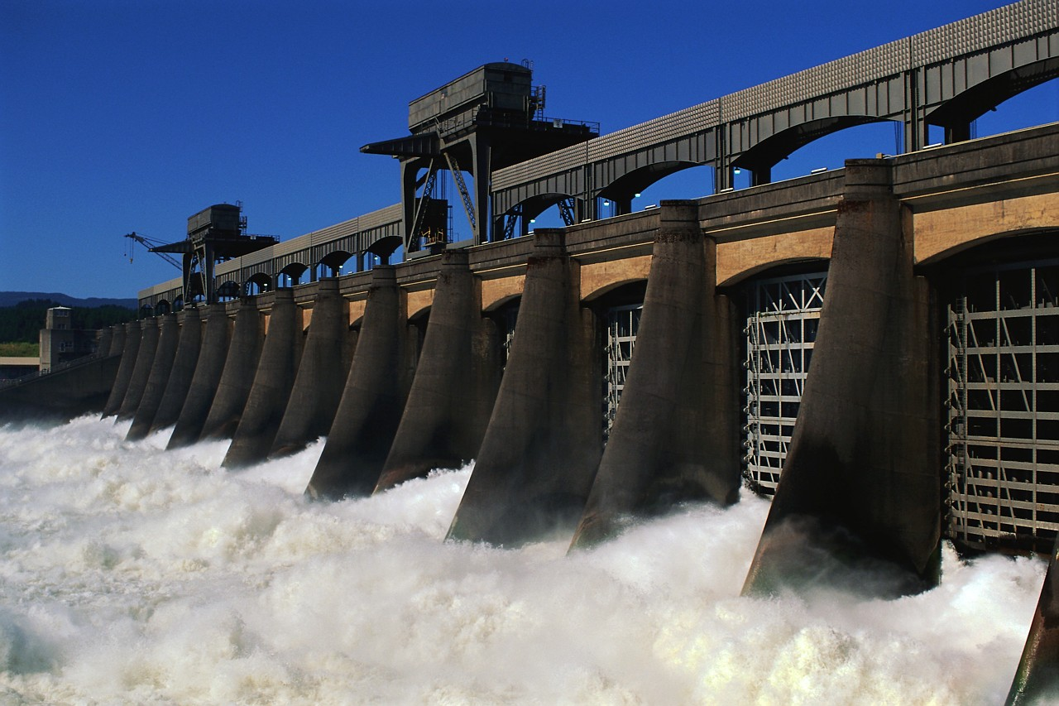
III. FORBIDDEN!!!
b. PROVERBS 17:14 “The beginning of Strife is as when one let’s out water: therefore leave off contention, before it be meddled with.”
It will always get worse than
what we think it will –
IT CAN AND WILL DESTROY
EVERYTHING IN IT”S PATH.

Slide 21
FORBIDDEN!!!
PROVERBS 20:3 “IT IS AN HONOR FOR A MAN TO CEASE FROM STRIFE: BUT EVERY FOOL WILL BE MEDDLING”
Pretty much self explanatory

Slide 22
FORBIDDEN!!!
d. PROVERBS 25:8 “Go not forth hastily to strive, lest thou know not what to do in the end thereof, when thy neighbor put thee to shame.”
This is kind of like putting your foot in your mouth

Slide 23
FORBIDDEN!!!
Putting your tongue in action before engaging the brain –
Starting something and then not knowing even what you are talking about or how to end what you have started.

Slide 24

FORBIDDEN!!!
PROVERBS 26:17 “He that passes by and meddles with strife belonging not to him, is like one that takes a dog by the ears.”
HE GETS BIT!!!!!!!

Slide 25
FORBIDDEN!!!
f. PHILIPPIANS 2:3 “Let nothing be done through strife(selfish ambition - NKJV) or vainglory (conceit - NKJV), but in lowliness of mind let each esteem others better than himself.”

Slide 26
FORBIDDEN!!!
2. WHY? Preach about it?
II TIMOTHY 2:14 “REMIND THEM OF THESE THINGS, CHARGING THEM BEFORE THE LORD NOT TO STRIVE ABOUT WORDS TO NO PROFIT TO THE RUIN OF THE HEARERS.”

Slide 27
FORBIDDEN!!!
  II TIMOTHY 2:24 “And a servant of the Lord must not Strive (quarrel – NKJV) but be gentle to all, able to teach, patient.”
  Are we God’s Servant?
  MATTHEW 6:16 & 20
“BY THEIR FRUITS YOU SHALL KNOW THEM.”

Slide 28
Lengthy Conclusion
Strife is the result of an improper attitude.
We are BRETHERN and THIS IS NOT THE WAY BRETHERN TREAT EACH OTHER.
IT IS THE RESULT OF WORLDY - CARNAL THINKING, A sign of a very weak Christian.
It comes from a tongue that is out of control.
It is a work of the flesh and not of the Spirit.

Slide 29
Conclusion
The Bible Forbids it.
It damages souls
We are to be reminded of this sin and the evilness of it for it turns people away from God.
It tells the world, the brethren and most importantly – GOD - all about our true character.
It is a sin and Gods judgment will not be that which no one wants;

Slide 30
STRIFE IS FORBIDDEN
Romans 13:13 "let us walk . . . not in strife and emulation.”
Let us be Peace Makers and therefore God’s Children
Matthew 5:9 “Blessed is the peacemakers: for they shall be called the children of God.”

Slide 31
What MUST You Do to Be Saved?
Hear The Word Of God Romans 10:17
Believe His Word Mark 16:16, John 8:24
Repent of your sins Luke 13:3, Acts 2:38
Confess your belief Romans 10:10, Acts 8:37
Be Baptized Mark 16:16, Acts 2:38 For the Remission of Your Sins Acts 22:16 Galatians 3:26, 27
Live Faithfully Titus 2:11-14

